Slide 1



Sales Performance Analysis Dashboard
I’m excited to share a recent project where I used Power BI to dive deep into sales data and uncover valuable business insights. This hands-on experience allowed me to apply data analytics techniques to solve real-world problems and make data-driven recommendations. Here's what I worked on:
🔍 Key Business Questions Explored:
📈 Analyzed sales revenue trends over time to identify seasonality and growth patterns.
🏆 Identified top-selling products and categories to optimize marketing and inventory strategies.
🌍 Explored regional sales performance to highlight high-potential markets and areas needing improvement. 💡 With Power BI's powerful visualizations and DAX calculations, I turned raw data into clear, actionable insights.
📌 This project helped sharpen my skills in:
Data cleaning and transformation (Power Query)
Data modeling and relationships
DAX for advanced measures
Storytelling with visuals and dashboards
Aniket Kamatwar
aniketkamatwar1330@gmail.com

Slide 2
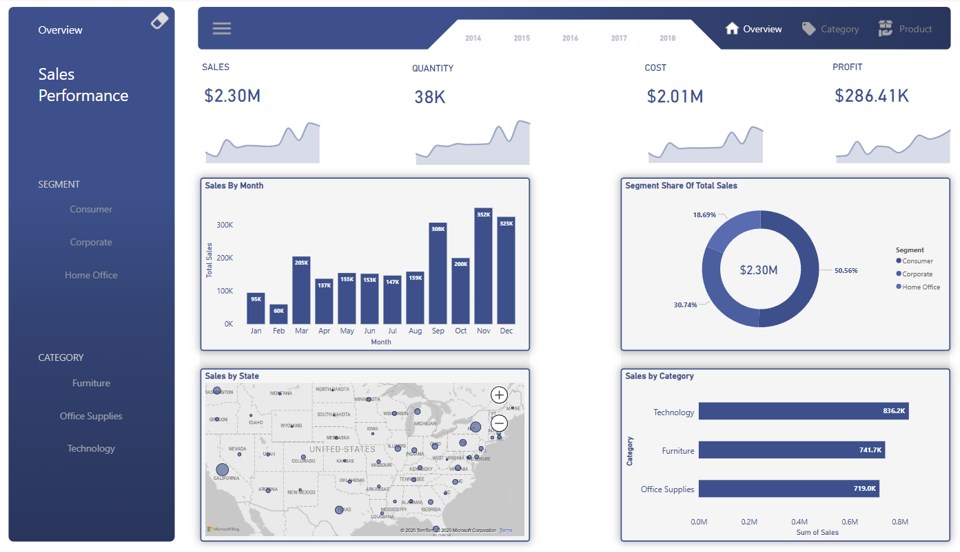

Slide 3
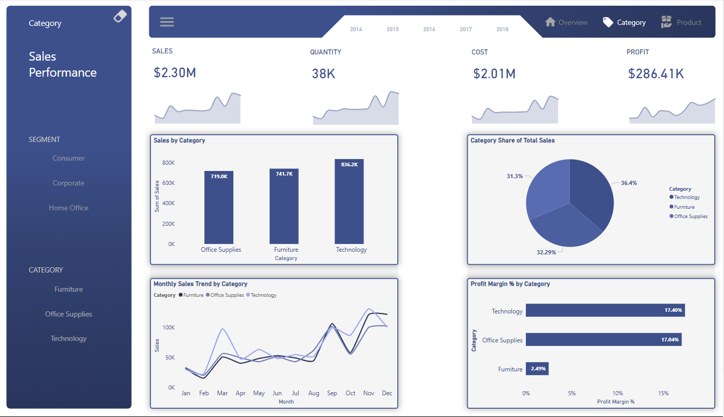

Slide 4
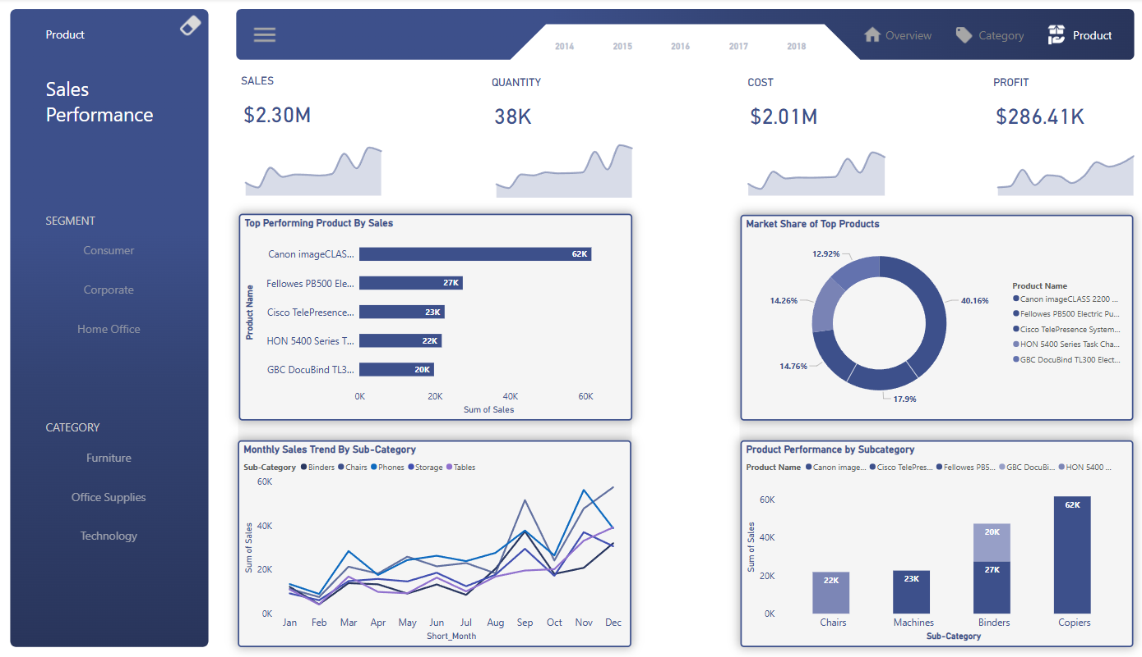

Slide 5
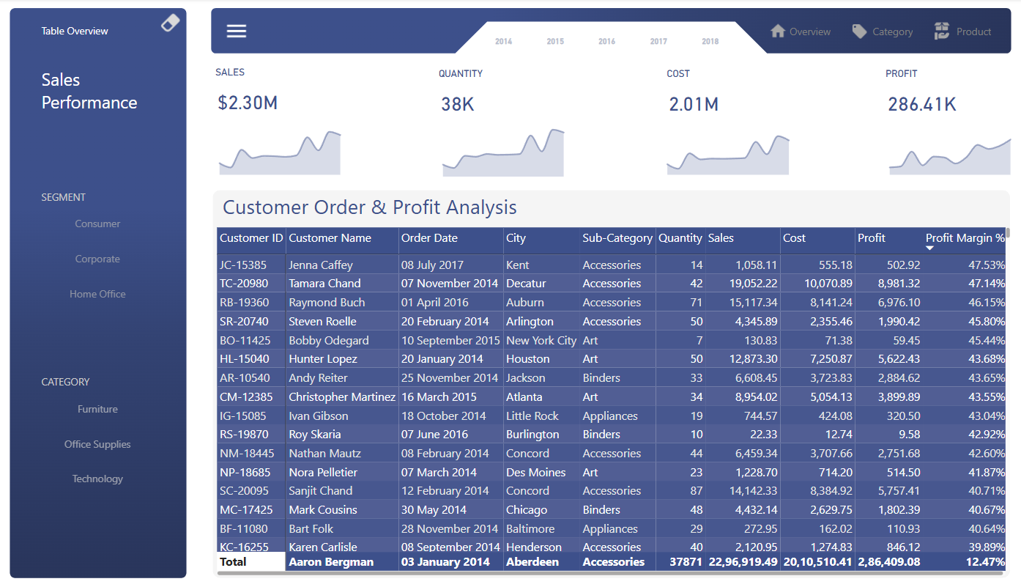

Slide 6
1

Slide 7
1
Analyzed sales revenue trends over time to identify seasonality and growth patterns
From the "Sales by Month" bar charts:
There is clear seasonality in sales:
Lowest sales occur in January and February (~95K & 60K).
Gradual growth from March to July (range 130K–155K).
Steady increase in August (159K) and significant spikes in September (308K), October (352K), and December (325K).
Peak in October (352K), suggesting a potential year-end push (e.g., holiday sales or year-end budgets).
Growth trend:
The overall trajectory is upward, with higher sales in the later months of the year.
This suggests seasonal demand spikes and possibly more promotional or clearance activities in Q4.

Slide 8
2

Slide 9
2
Identified top-selling products, categories & profit margin optimize marketing and inventory strategies
Top products:
Canon imageCLASS 2200 is the top performer (~62K sales).
Followed by: Fellowes PB500 (27K), Cisco TelePresence (23K), HON 5400 Series (22K), and GBC DocuBind (20K).
Top categories:
Technology leads with 836.2K in sales.
Followed by: Furniture (741.7K) and Office Supplies (719K).
Market share of top products:
Canon imageCLASS holds a 40% share, indicating high dependence on this product for revenue.
Profit margin by category:
Technology and Office Supplies have similar high profit margins (~17%).
Furniture has a lower margin (2.49%), suggesting potential areas for cost optimization or pricing adjustments.

Slide 10
3

Slide 11
3
Explored regional sales performance to highlight high-potential markets and areas needing improvement
High-concentration sales are in:
California
Texas
East Coast states (New York, Pennsylvania, etc.)
These regions are high-potential markets, indicating:
Opportunities to strengthen presence through targeted marketing.
Possible distribution/logistics enhancements in these regions to support growing demand.

Slide 12
4

Slide 13
4
Summary of insights
Seasonality:
Lower sales early in the year; steady growth with year-end spikes.
Top Products & Categories:
Focus on Canon imageCLASS 2200 & Technology category for
marketing/inventory optimization.
Regional Hotspots:
Prioritize California, Texas, and East Coast for expansion and market
penetration.

